Slide 1

Information technology & Data analysis– Final presentation
-restaurant visitor forecasting
Amr Sarhan/ Babak Barghi/ Daniel Zöttl
21st December, 2020

Slide 2

Agenda
1
Problem overview
2
ER diagram
3
Risk matrix
4
Queries
5
Prediction
6
Explorative analysis
7
Conclusion & Further Suggestions

Slide 3
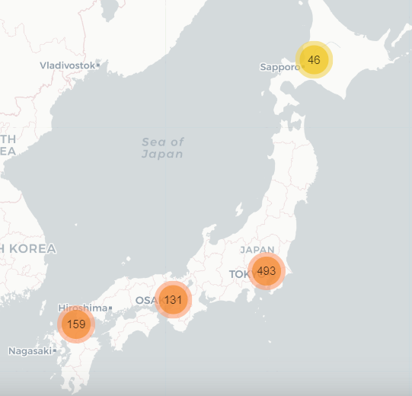


All restaurants’ information provided are located all over Japan.
located in Japan
Serve the Japanese market
Restaurants reservation control and cash register software
Portfolio offers food of different genres for all kind of tastes
Forecast future restaurant visitors on a given date
Help restaurants be much more efficient
Allow restaurants to focus on creating an enjoyable dining experience for their customers
1

Slide 4
Agenda
1
Project overview
2
ER diagram
3
Risk matrix
4
Queries
5
Prediction
6
Explorative analysis
7
Conclusion & benefits

Slide 5
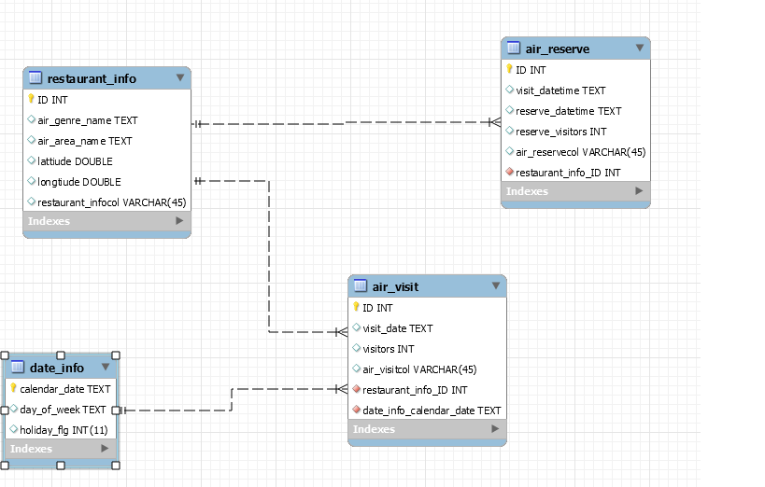
ER diagram connect 4 tables (restarants_info,air_reserve,air_visit,date_info)
Summary
Restaurant_info table is connected to air_reserve and air_visit table by one to many relationships.
Date_info table is connected by one to many relationship with air_vsit table.
ER diagram
2

Slide 6
Agenda
1
Company overview
2
Business opportunity
3
Risk matrix
4
Queries
5
Prediction
6
Explorative analysis
7
Conclusion & benefits

Slide 7
Our reservation and cash register system can help restaurants avoid unexpected troubles popping up that could hurt business
Impact
scale
3
1
1
Purchase ingredients more than their need
2
Schedule more or less staff than needed
2
3
Bad dining experience to the customers
Probability
Risk matrix
3

Slide 8
Agenda
1
Company overview
2
ER diagram
3
Risk matrix
4
Queries
5
Prediction
6
Explorative analysis
7
Conclusion & benefits

Slide 9
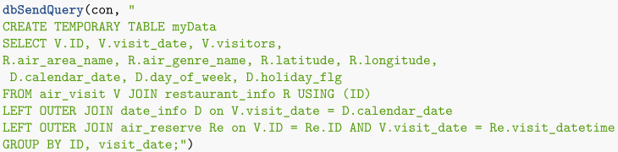

Queries
Create database
Create a table with all days for each restaurant and all required variables
Create the sum of reservations for each day ans restaurant
Queries
4

Slide 10
Agenda
1
Company overview
2
Business opportunity
3
Risk matrix
4
Queries
5
Prediction
6
Explorative analysis
7
Conclusion & benefits

Slide 11
Prediction
Data check for missing values
Imputation of missing values
Add some new variables
Create trainset and testset
Try different models
Calculate the R² value
Prediction
5

Slide 12
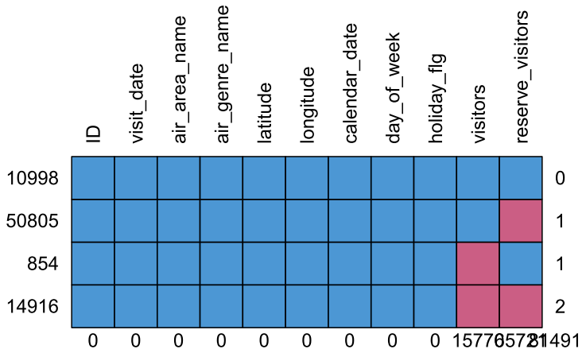
Check Data for missing values
Imputation of missing values
About 65000 missing values for reservations
Replace the NAs by 0
About 16000 missing values for visitors
This are the values that should be predicted
Prediction
6

Slide 13
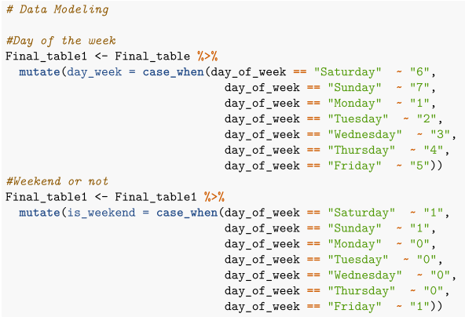
Add some new variables
Day_week
Change the type from charcater to numeric
is_weekend
Mark which days belong to the weekend
Change the type from character to numeric
Prediction
7

Slide 14
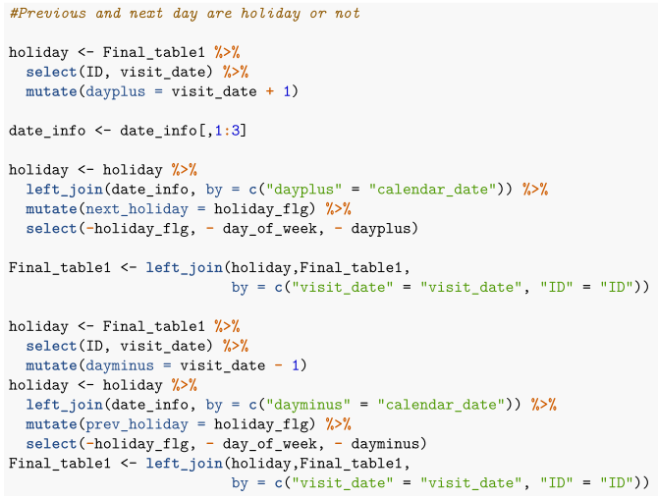
Add some new variables
Prev_holiday
Checks, if the previous day is a holiday
Next_holiday
Checks, if the next day is a holiday
Prediction
8

Slide 15
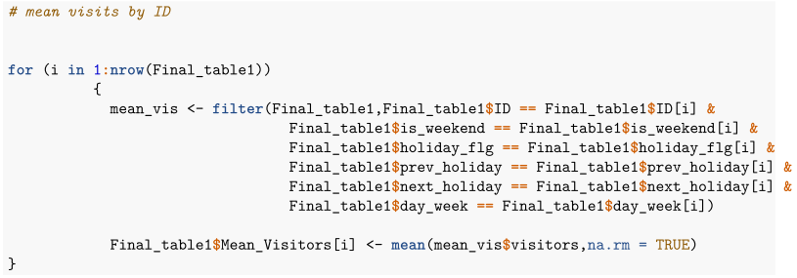
Add some new variables
Mean_visitors
Filters for each line all entries that have the same variable values as the line with index [i]
Calculates the mean of the visitors
Adds this value to every single row
Prediction
9

Slide 16

Create train and test set
Try different models
Train_set
Includes all entries from January to February
Test_set
Includes all entries of march
R² of 0,72
R² of 0,7255
R² of 0,7278
Prediction
10

Slide 17
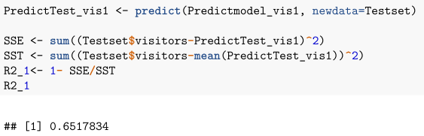
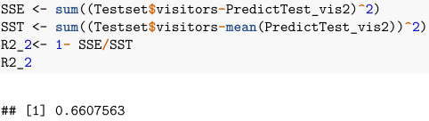
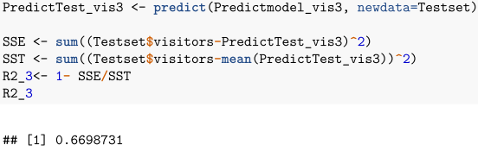
Calculate R²
R² of model 1 is 0,652
R² of model 2 is 0,661
R² of model 3 is 0,669
- > We decide to make the prediction with model 3
Prediction
11

Slide 18
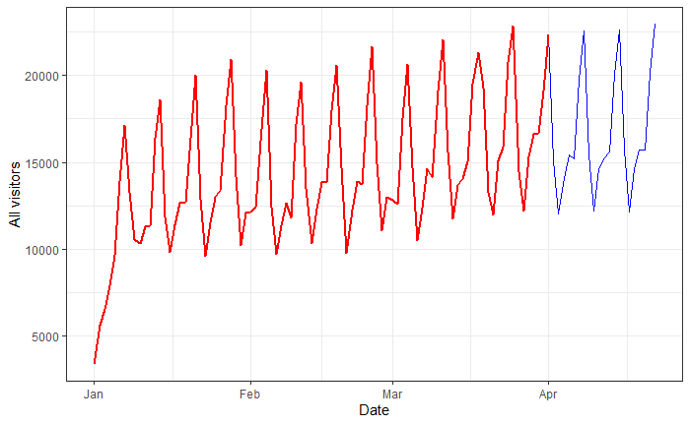
Results
Increasing trend of visitors
Importance of historical data for prediction model
12

Slide 19
Agenda
1
Company overview
2
ER diagram
3
Risk matrix
4
Queries
5
Prediction
6
Explorative analysis
7
Conclusion & benefits

Slide 20
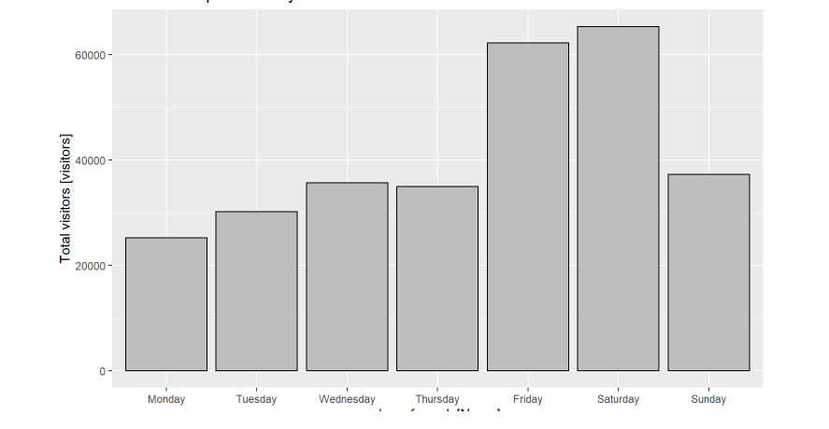
The day before the weekend and the first day if the weekend are the days with the most visits
Distribution of visitors on weekdays
Restaurants can prepare to Friday and Saturday surge in visitors
Restaurants can learn to adjust ingredients and staff based on the day.
Explorative analysis
13

Slide 21
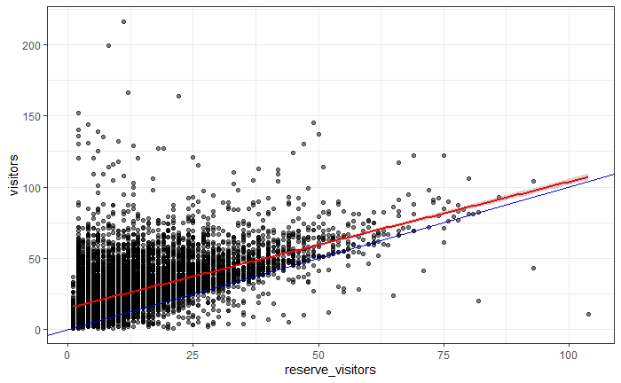
Reserves and actual visits
Summary
The blue line shows *reserve_visitors = visitors* and the red line is a linear fit.
There are more visitors in days than reservations . (walk-in customers)
There are reservations weren’t fulfilled.
Explorative analysis
14

Slide 22
Agenda
1
Company overview
2
Business opportunity
3
Risk matrix
4
Queries
5
Prediction
6
Explorative analysis
7
Conclusion & Further Suggestions

Slide 23
Further Suggestions
- More Feature Explorations
Number of visitors to a restaurant certainly depends more things on its reservations, genre or area.
There could also be a correlation between the social-economic conditions of the neighbourhood, other attributes like the vibe of the restaurant itself and the number of visitors.
- Times Series Models
By now the visitor's data is available on a daily basis, but if it will be available on an hourly basis then we can further reduce the scale of prediction to next hour visitors prediction.
It will give more control to restaurants in terms of being prepared for the next hour rush and thus further improvement of productivity and food delivery time.
15

Slide 24
Thank you for your attention!

